Slide 1
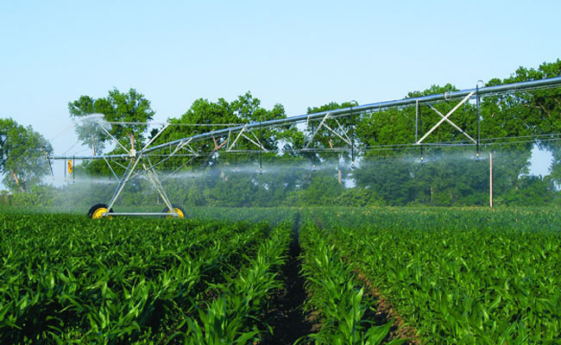
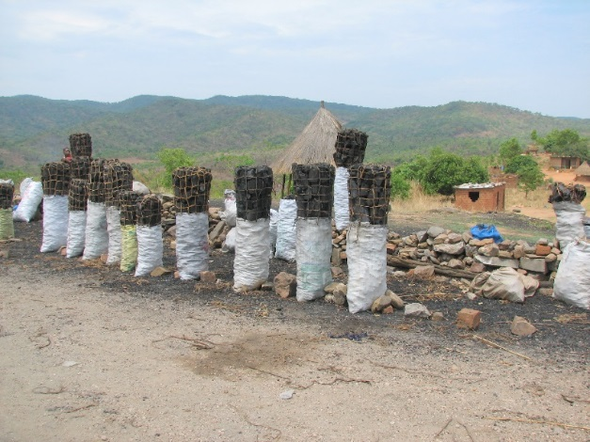
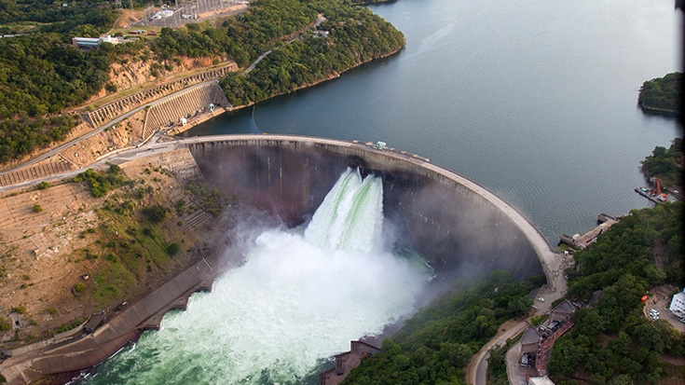
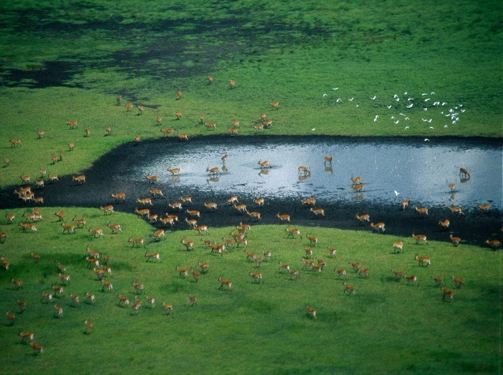
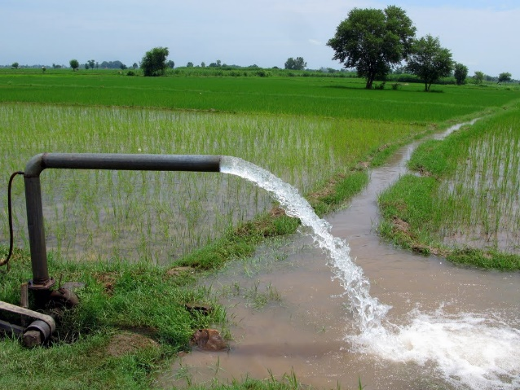
Exercise 4: Select a basin
Peter Burek, Mikhail Smilovic, Luca Guillaumot
International Institute for Applied Systems Analysis
Research Scholars at
Water Program

Slide 2

Select a basin
0. What you need – downloading data from FTP
Lumped vs. distributed modelling
The world at 30 arcsec
From elevation to flow accumulation
Example for Lake Tana, Blue Nile, Ethiopia
Notes:
Improvement in resolution of CWatM model for basin analysis to show more details locally.

Slide 3
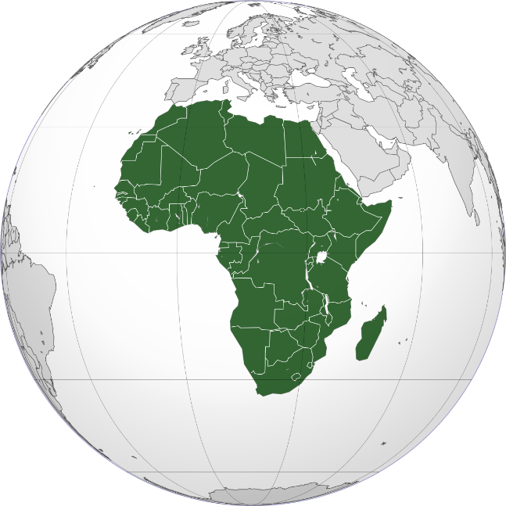
Select a basin
0. What you need
You downloaded already all global static data for 30 arcmin e.g. global soil data on 30 arcmin from:
from CWATM_data\cwatm_input30min.zip
You need a global climate dataset (precipitation, temperature, radiation etc.) please download from our ftp server
climate_2011_2012 .zip from
please copy to the folder CWATM_data/climate/global and unzip (extract here)
Notes:
Improvement in resolution of CWatM model for basin analysis to show more details locally.

Slide 4
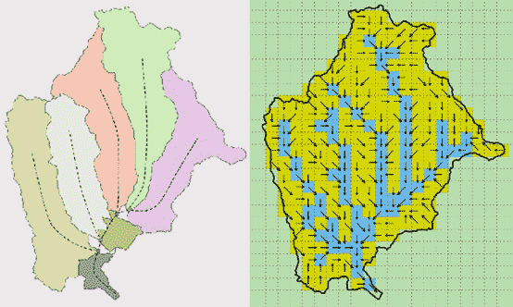
Select a basin
Lumped and distributed modeling
CWatM is a distributed model which can be used at different resolutions e.g. 30 arcmin, 5 arcmin, 1km
Other hydrological models use a lumped model approach (e.g. SWAT)
Lumped model vs. distributed model (source: http://crahi.upc.edu)
Notes:
Improvement in resolution of CWatM model for basin analysis to show more details locally.

Slide 5
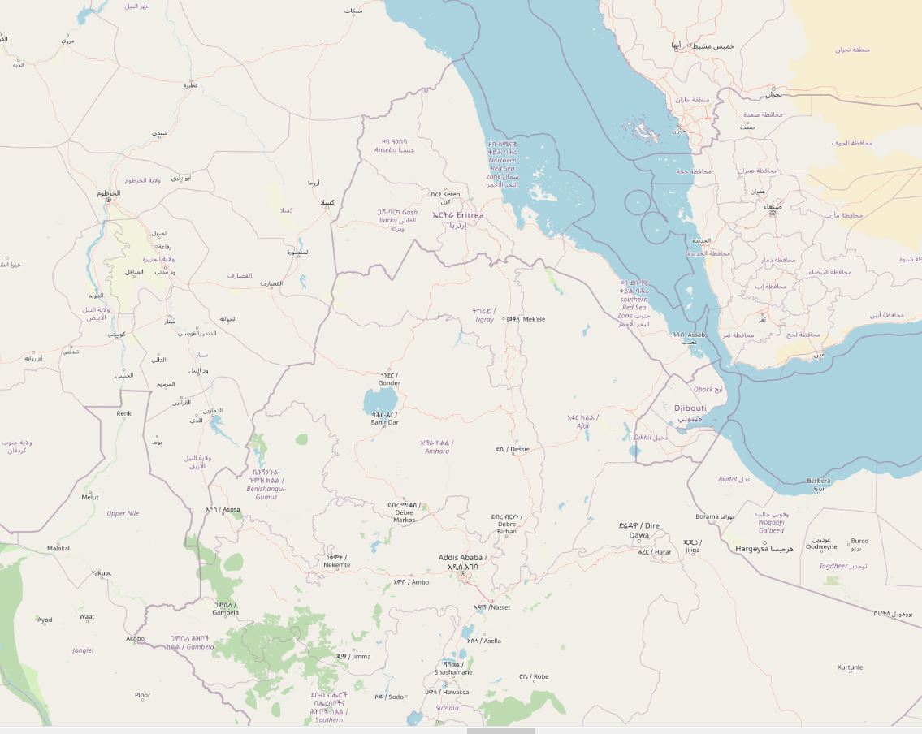
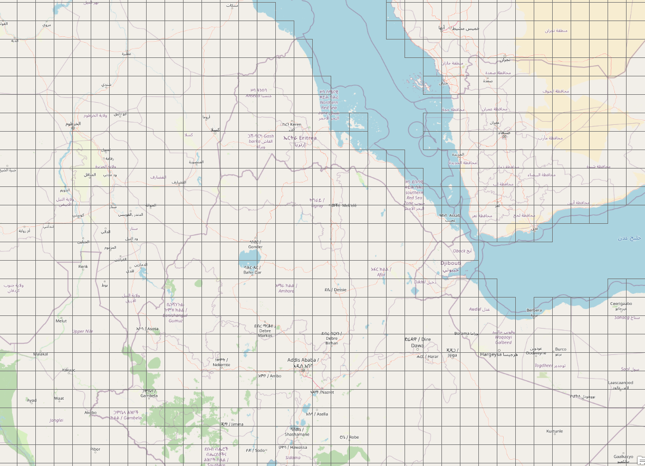
Select a basin
2. The world in 30 arcmin raster
CWatM is a distributed model which can be used at different resolutions e.g. 30 arcmin, 5 arcmin, 1km
This is a part of the World (Ethiopia) split into 30 arcmin cells (around 50 km x 50 km)
Notes:
Improvement in resolution of CWatM model for basin analysis to show more details locally.

Slide 6
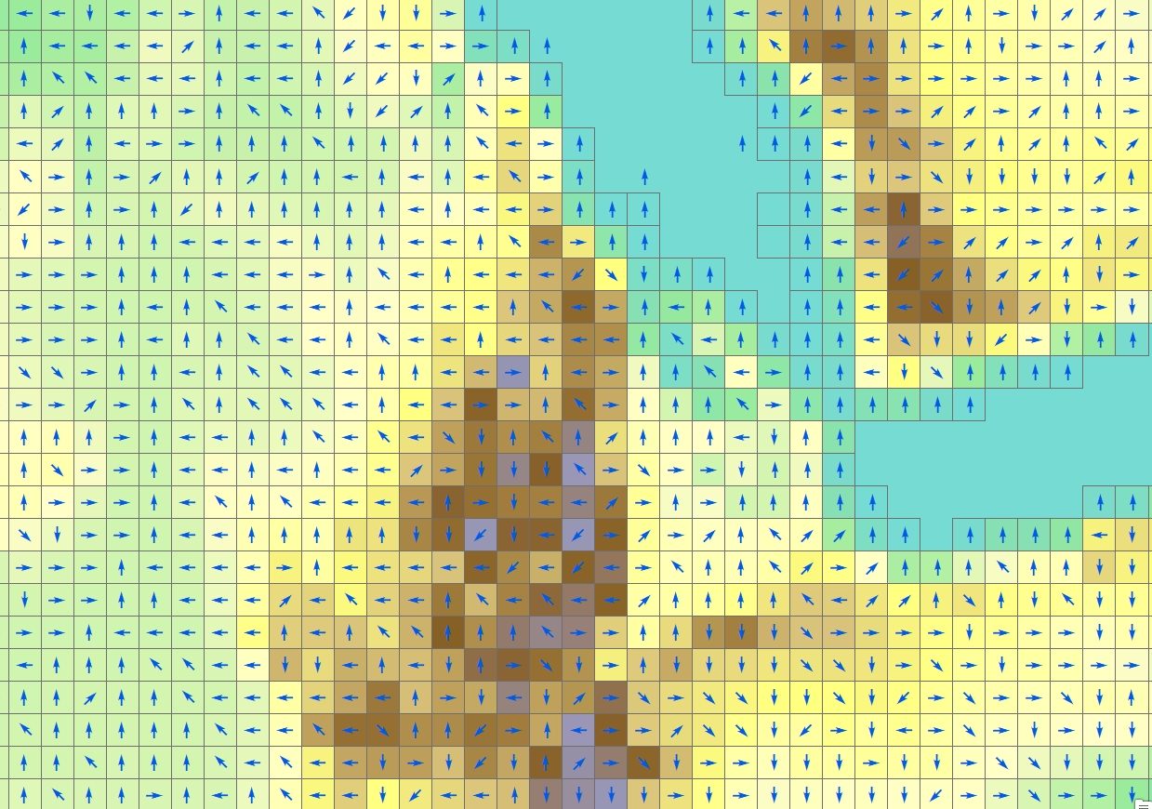
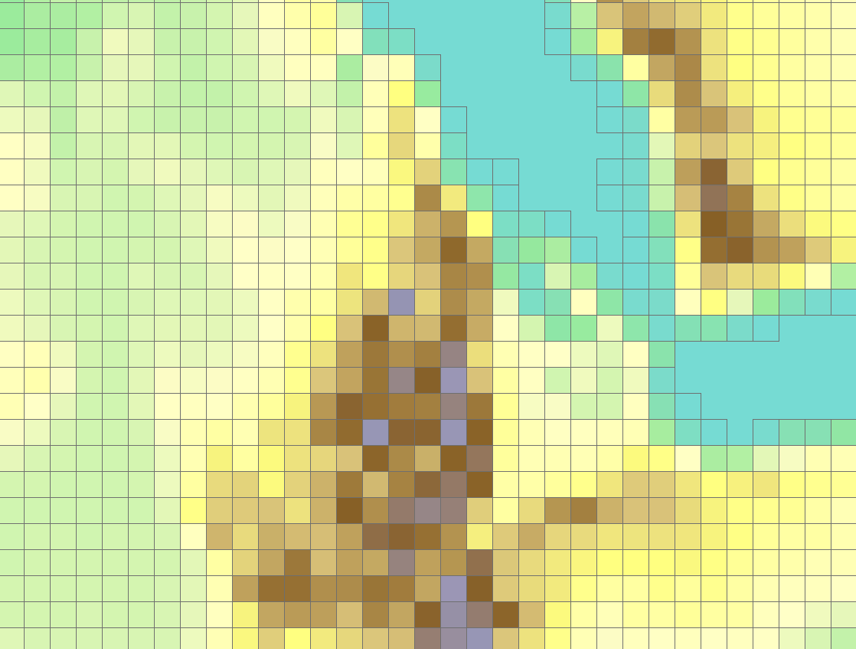
Select a basin
3. DEM to flow direction
Based on a digital elevation model for each cell a flow direction is calculated
This flow direction is from: DDM30 River-routing network data (Lehner et al., 2008)
Notes:
Improvement in resolution of CWatM model for basin analysis to show more details locally.

Slide 7
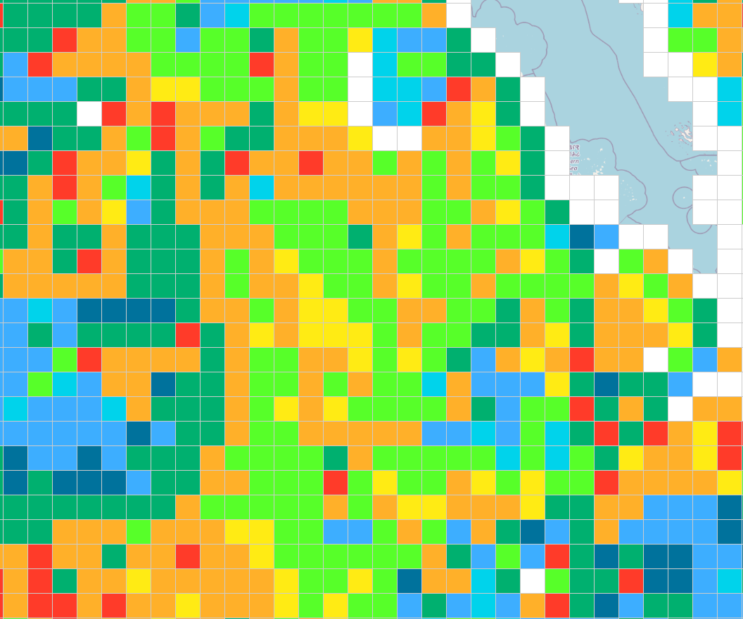
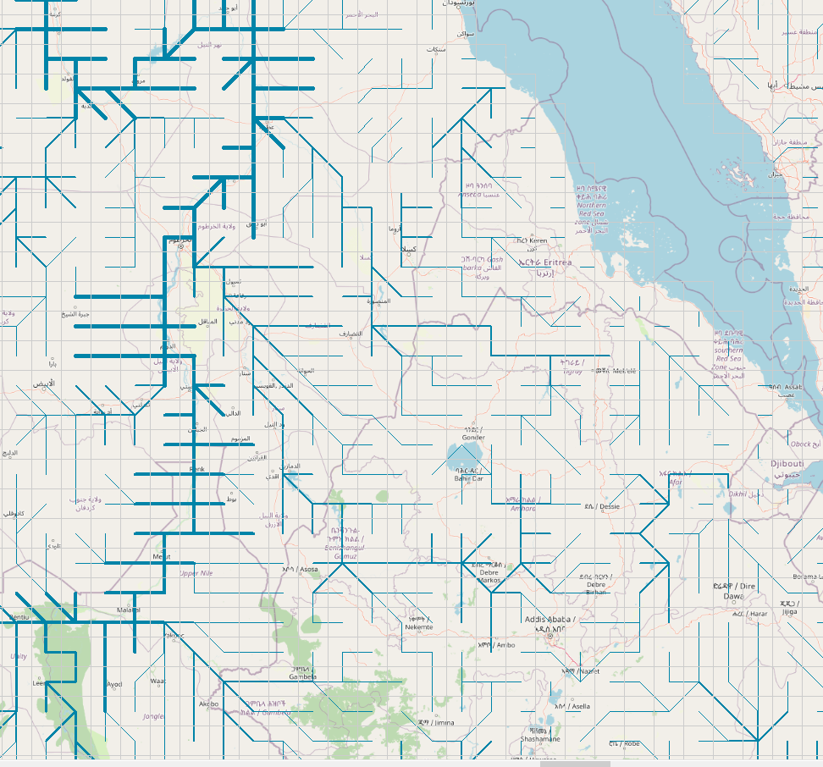
Select a basin
4. Flow direction to stream network
Each flow direction gets a number (like the number keyboard)
If you connect the flow direction you get to an upstream – downstream connection – the stream network
Notes:
Improvement in resolution of CWatM model for basin analysis to show more details locally.

Slide 8
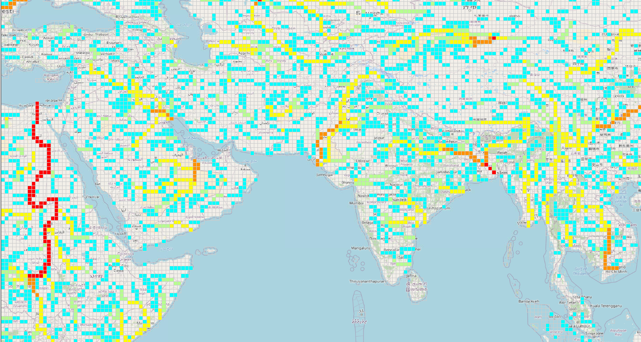
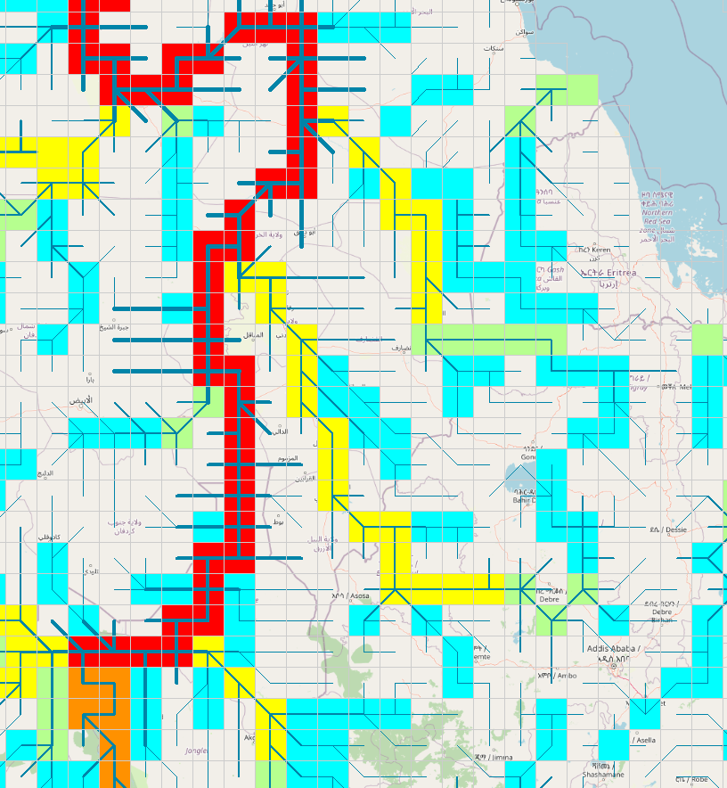
Select a basin
5. Stream network to flow accumulation map
Each cell has an area (e.g. 30arcmin x 30 arcmin)
If you sum up all upstream areas for each cell you get to the upstream area. The value is representation the upstream catchment area of this cell
Notes:
Improvement in resolution of CWatM model for basin analysis to show more details locally.

Slide 9
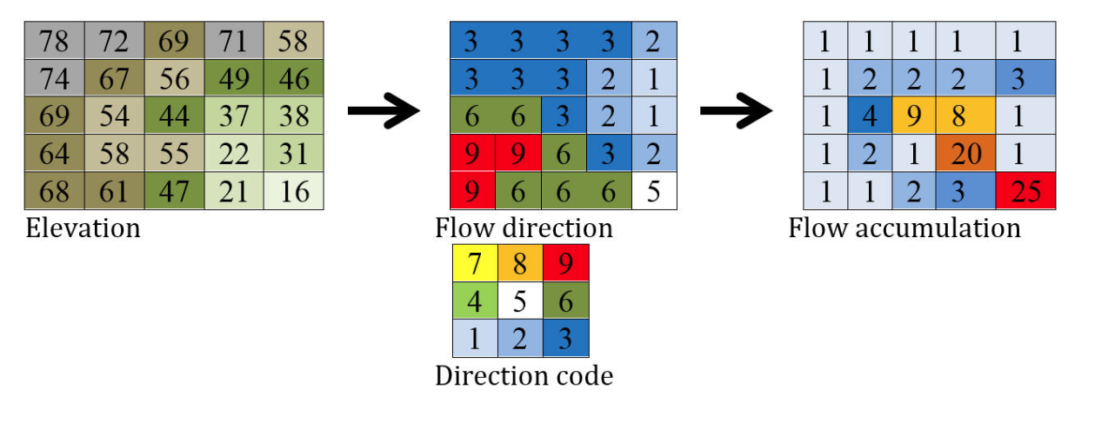
Select a basin
6. In short: from elevation to flow accumulation
See also: https://cwatm.iiasa.ac.at/data.html#river-drainage-maps
Notes:
Improvement in resolution of CWatM model for basin analysis to show more details locally.

Slide 10
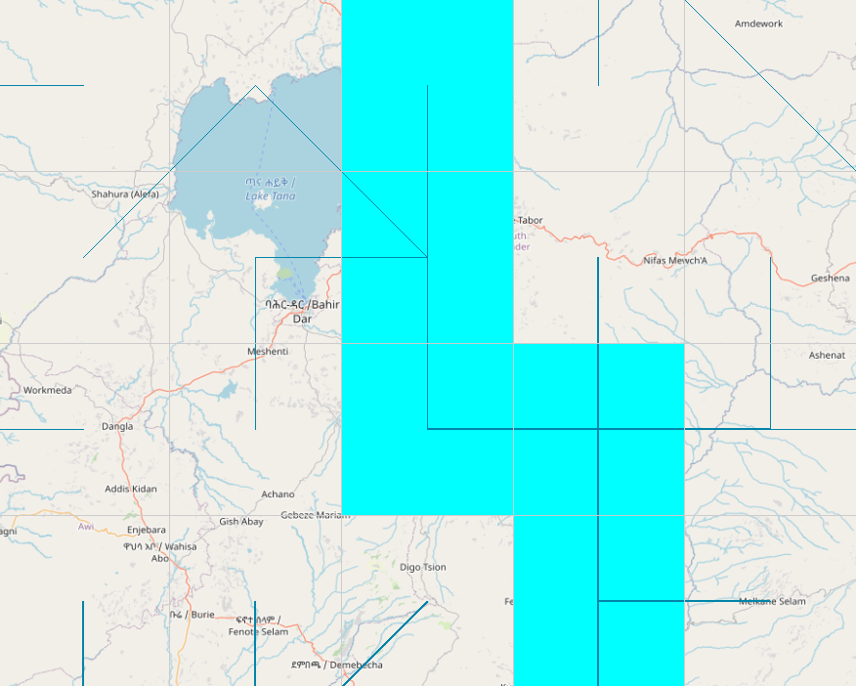
Select a basin
7. Why is this important?
You have to find the right location for your basin and your discharge station as the network, data, an reality sometimes does not fit.
30 arcmin network outlet
Real location of outlet of lake Tana
Lake Tana, Ethiopia
Notes:
Improvement in resolution of CWatM model for basin analysis to show more details locally.

Slide 11
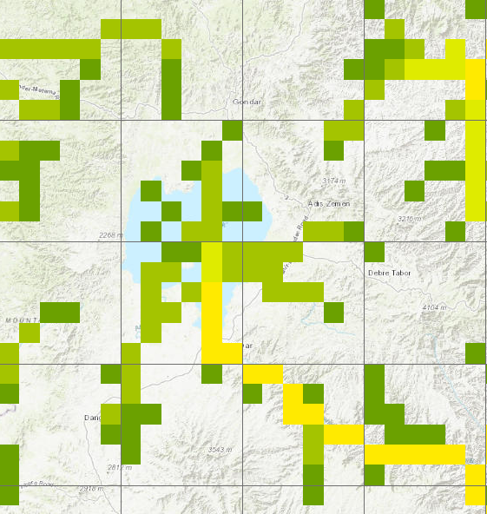
Select a basin
8. Why is this important?
Good news: This is getting better if you reduce resolution!
Real location of outlet of lake Tana
and 5 arcmin network outlet
Lake Tana, Ethiopia
Notes:
Improvement in resolution of CWatM model for basin analysis to show more details locally.

Slide 12
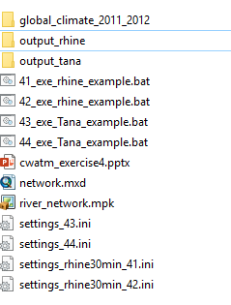
Exercise: Select a basin
1. Select an outlet of a basin
Folder: CWATM_exercise4
Based on the Rhine basin:
At the moment the Rhine basin is using a limited set of climatic data, cut to the basin extend.
Run:
..\CWATM_model\CWatMexe\cwatm.exe settings_rhine30min_41.ini
Or: 41_exe_rhine_example.bat
For: original Rhine basin with cut climatic data
Folder structure CWATM_exercise4
Important!
We are in folder CWATM_exercise4 but we using the model stored in CWATM_model
Notes:
Improvement in resolution of CWatM model for basin analysis to show more details locally.

Slide 13
Exercise: Select a basin
1. Select an outlet of a basin
Based on the Rhine basin:
At the moment the Rhine basin is using a limited set of climatic data, cut to the basin extend.
To use the global climate data
Change a few line in the setting: settings_rhine30min_41.ini
And save it with the same name.
calc_evaporation = True Calculate potential Evaporation
PathOut = ./output_rhine Change output destination
PathMeteo = $(PathRoot)/climate/global Change to folder with global climatic data
#StepEnd = 31/12/2010
StepEnd = 10 Change to 100 time steps
PrecipitationMaps = $(FILE_PATHS:PathMeteo)/pr* Change precipitation input file
TavgMaps = $(FILE_PATHS:PathMeteo)/tavg* Change average temperature input file
You can use the ‘#’ to out comment a line and to keep in mind the original version!
Notes:
Improvement in resolution of CWatM model for basin analysis to show more details locally.

Slide 14
Exercise: Select a basin
1. Select an outlet of a basin
Based on the Rhine basin:
After your changes it should run with global climatic data
Run again:
..\CWATM_model\CWatMexe\cwatm.exe settings_rhine30min_41.ini
Or: 41_exe_rhine_example.bat
For: original Rhine basin with cut climatic data
(in case you did not manage, we prepared a settings file with the changes
..\CWATM_model\CWatMexe\cwatm.exe settings_rhine30min_42.ini
For: original Rhine basin with global climatic data)
Notes:
Improvement in resolution of CWatM model for basin analysis to show more details locally.

Slide 15
Exercise: Select a basin
2. Select an outlet of a basin
Lake Tana, Blue Nile, Ethiopia (thank you Meron)
Station name | Drainage area (km²) | Latitude | Longitude
Abbay at Bahir Dar | 15321 | 11.6 | 37.39
Change a few line in the setting: settings_rhine30min_41.ini
PathOut = ./output_tana
MaskMap = 37.39 11.6
Gauges = 37.39 11.6
This will change the basin from Rhine to Lake Tana
StepEnd = 10
Notes:
Improvement in resolution of CWatM model for basin analysis to show more details locally.

Slide 16
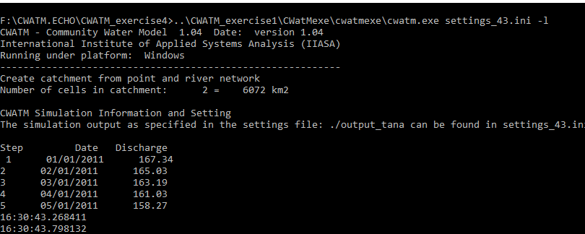
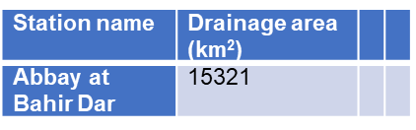
Exercise: Select a basin
2. Select an outlet of a basin
Tana basin
Run again:
..\CWATM_model\CWatMexe\cwatm.exe settings_rhine30min_41.ini For: original Tana outlet coordinates
Basin area too small
(in case you did not manage, we prepared a settings file with the changes
..\CWATM_model\CWatMexe\cwatm.exe settings_43.ini
Notes:
Improvement in resolution of CWatM model for basin analysis to show more details locally.

Slide 17
Exercise: Select a basin
3. Select an outlet of a basin
Lake Tana, Blue Nile, Ethiopia
Station name | Drainage area (km²) | Latitude | Longitude
Abbay at Bahir Dar | 15321 | 11.6 | 37.39
Because the 30arcmin network
does not fit completely, we shift the outlet
one cell to the east
Change a few line in the setting:
MaskMap = 37.6 11.6
Gauges = 37.6 11.6
30 arcmin network outlet
Real location of outlet of lake Tana
Lake Tana, Ethiopia
This is a bit different then before!
Notes:
Improvement in resolution of CWatM model for basin analysis to show more details locally.

Slide 18
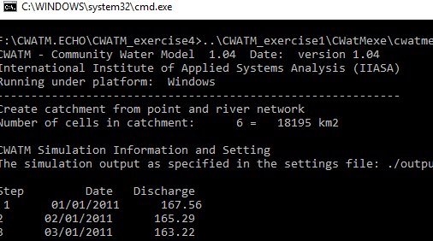
Exercise: Select a basin
3. Select an outlet of a basin
Tana basin
Run:
..\CWATM_exercise4\CWatMexe\cwatmexe\cwatm.exe settings_rhine30min_41.ini
For: changed Tana outlet coordinates
Basin area fits better
(in case you did not manage, we prepared a settings file with the changes
..\CWATM_exercise1\CWatMexe\cwatmexe\cwatm.exe settings_44.ini
Notes:
Improvement in resolution of CWatM model for basin analysis to show more details locally.

Slide 19
Exercise: Select a basin
4. Select an outlet of a basin
Lake Tana, Blue Nile, Ethiopia
Station name | Drainage area (km²) | Latitude | Longitude
Abbay at Bahir Dar | 15321 | 11.6 | 37.39
Change a few line in the setting:
StepEnd = 31/12/2012
30 arcmin network outlet
Real location of outlet of Lake Tana
Lake Tana, Ethiopia
Notes:
Improvement in resolution of CWatM model for basin analysis to show more details locally.

Slide 20
Exercise: Select a basin
4. Select an outlet of a basin
Based on the Rhine basin:
At the moment the Rhine basin is using a limited set of climatic data, cut to the basin extend.
Run:
..\CWATM_model\CWatMexe\cwatm.exe settings_rhine30min_41.ini
For a longer times serie
Notes:
Improvement in resolution of CWatM model for basin analysis to show more details locally.

Slide 21
Problems
Most problems come from different file systems, folder structures
We try to set up everything with relative path.
Please make sure that your folders have a similar structure like in slide 3 in cwatm_exercise1.ppt
The settings file has a part:
[FILE_PATHS]
PathRoot = ../cwatm_data ../ jumps back to the previous folder
PathOut = ./output ./ uses the folder output in the same folder as the settings file or the directory you are in
PathMaps = $(PathRoot)/cwatm_input30min
PathMeteo = $(PathRoot)/climate/rhine
3. If this is not working you can use also absolute path (also with white space)
PathRoot = C/root directory/second.root/cwatm/cwatm_data
4. If you execute cwatm you can also use absolute path
instead
../CWATM_model/CWatMexe/cwatm.exe settings_rhine30min.ini –l
“C/root directory/second.root/cwatm/CWATM_model/CWatMexe/cwatm.exe” settings_rhine30min.ini –l (mind the “ if there are white spaces)
5. Some other errors we address in:
https://cwatm.iiasa.ac.at/tutorial.html#test-the-python-model-version
Notes:
Improvement in resolution of CWatM model for basin analysis to show more details locally.

